Slide 1





Resource Group
Virtual Network
Subnet & Network Security Group
Virtual Machine Scale Set

Slide 2
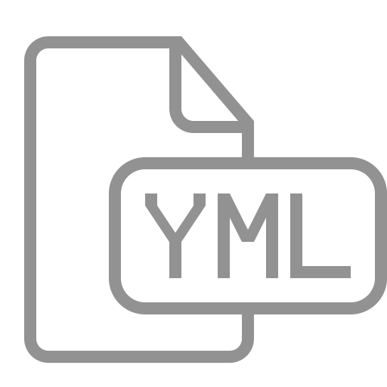

pipeline.yml
Pipeline Stage template
pipeline.jobs.yml
Pipeline Jobs template
<env>.scaleset.bicep
Bicep Deployment files
PowerShell scripts
💪
scaleset.deploy.bicep
Bicep Template file
<env>.agentpool.config.json
AgentPool Config
💪
{}
main.bicep
Bicep CARML modules
💪

Slide 3




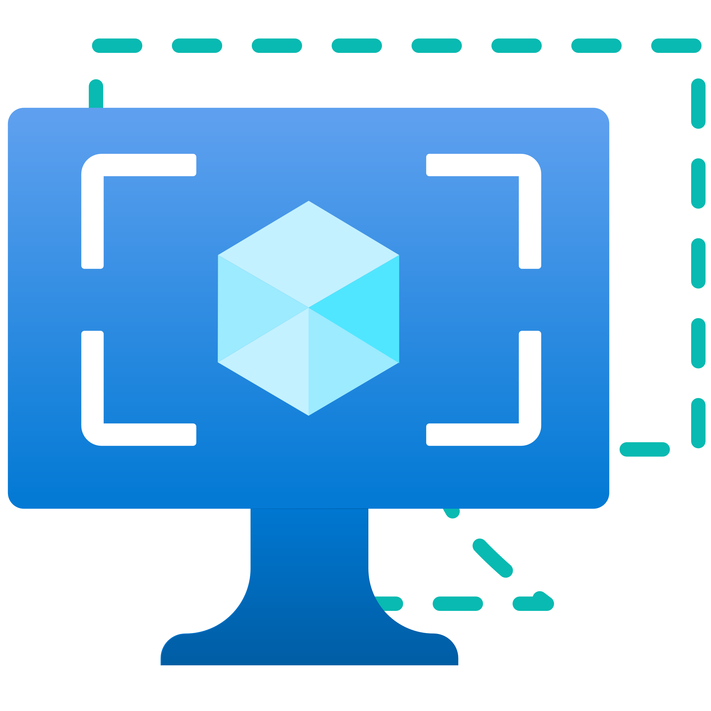

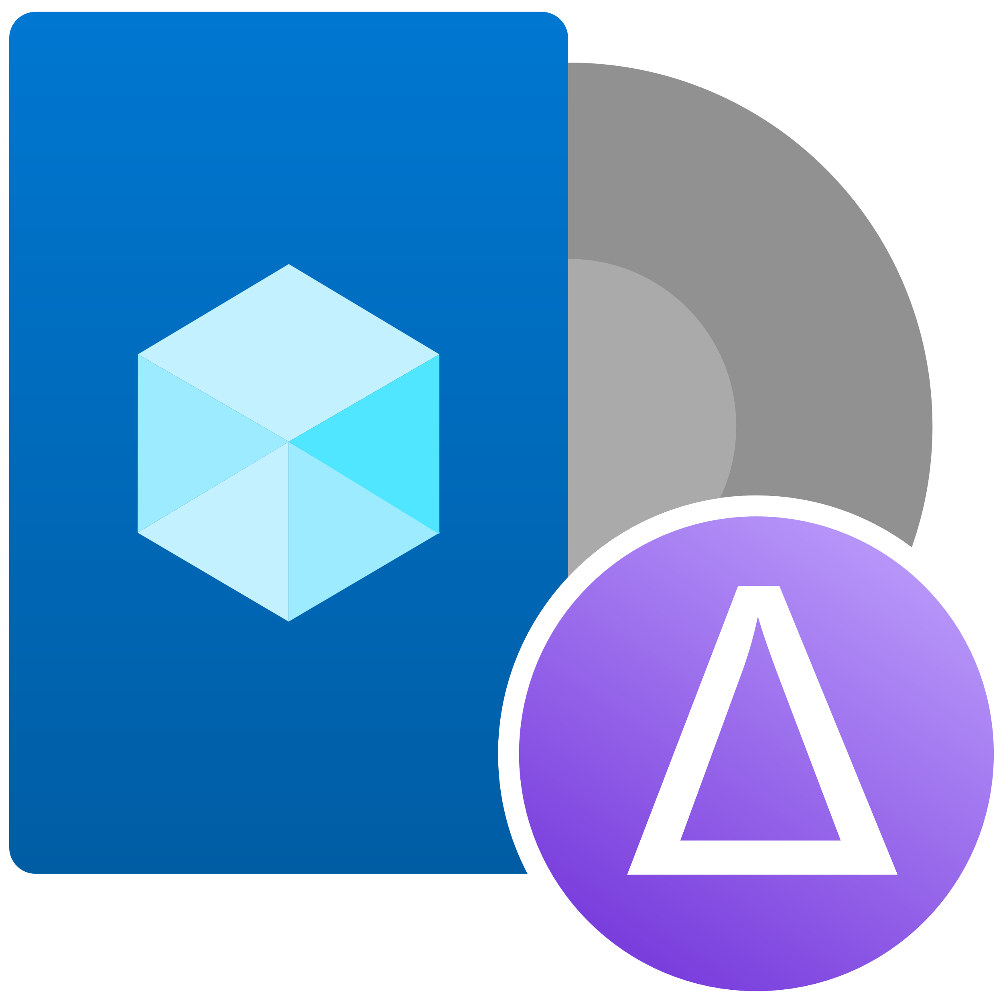

Image Resource Group
Resource Group
Azure Compute Gallery
Image
User-Assigned Identity
Deployment Script
User-Assigned Identity
Image (Definition)
Image Version
Trigger
Deployment Script
Image Template
Assets
Storage Account
Virtual Network
Storage Upload
Deployment Script
Deployment Script
Storage Account

Slide 4
pipeline.yml
Pipeline Stage template
pipeline.jobs.yml
Pipeline Jobs template
<env>.image.bicep
Bicep Deployment files
PowerShell scripts
💪
image.deploy.bicep
Bicep Template file
💪
main.bicep
Bicep CARML modules
💪

Slide 5




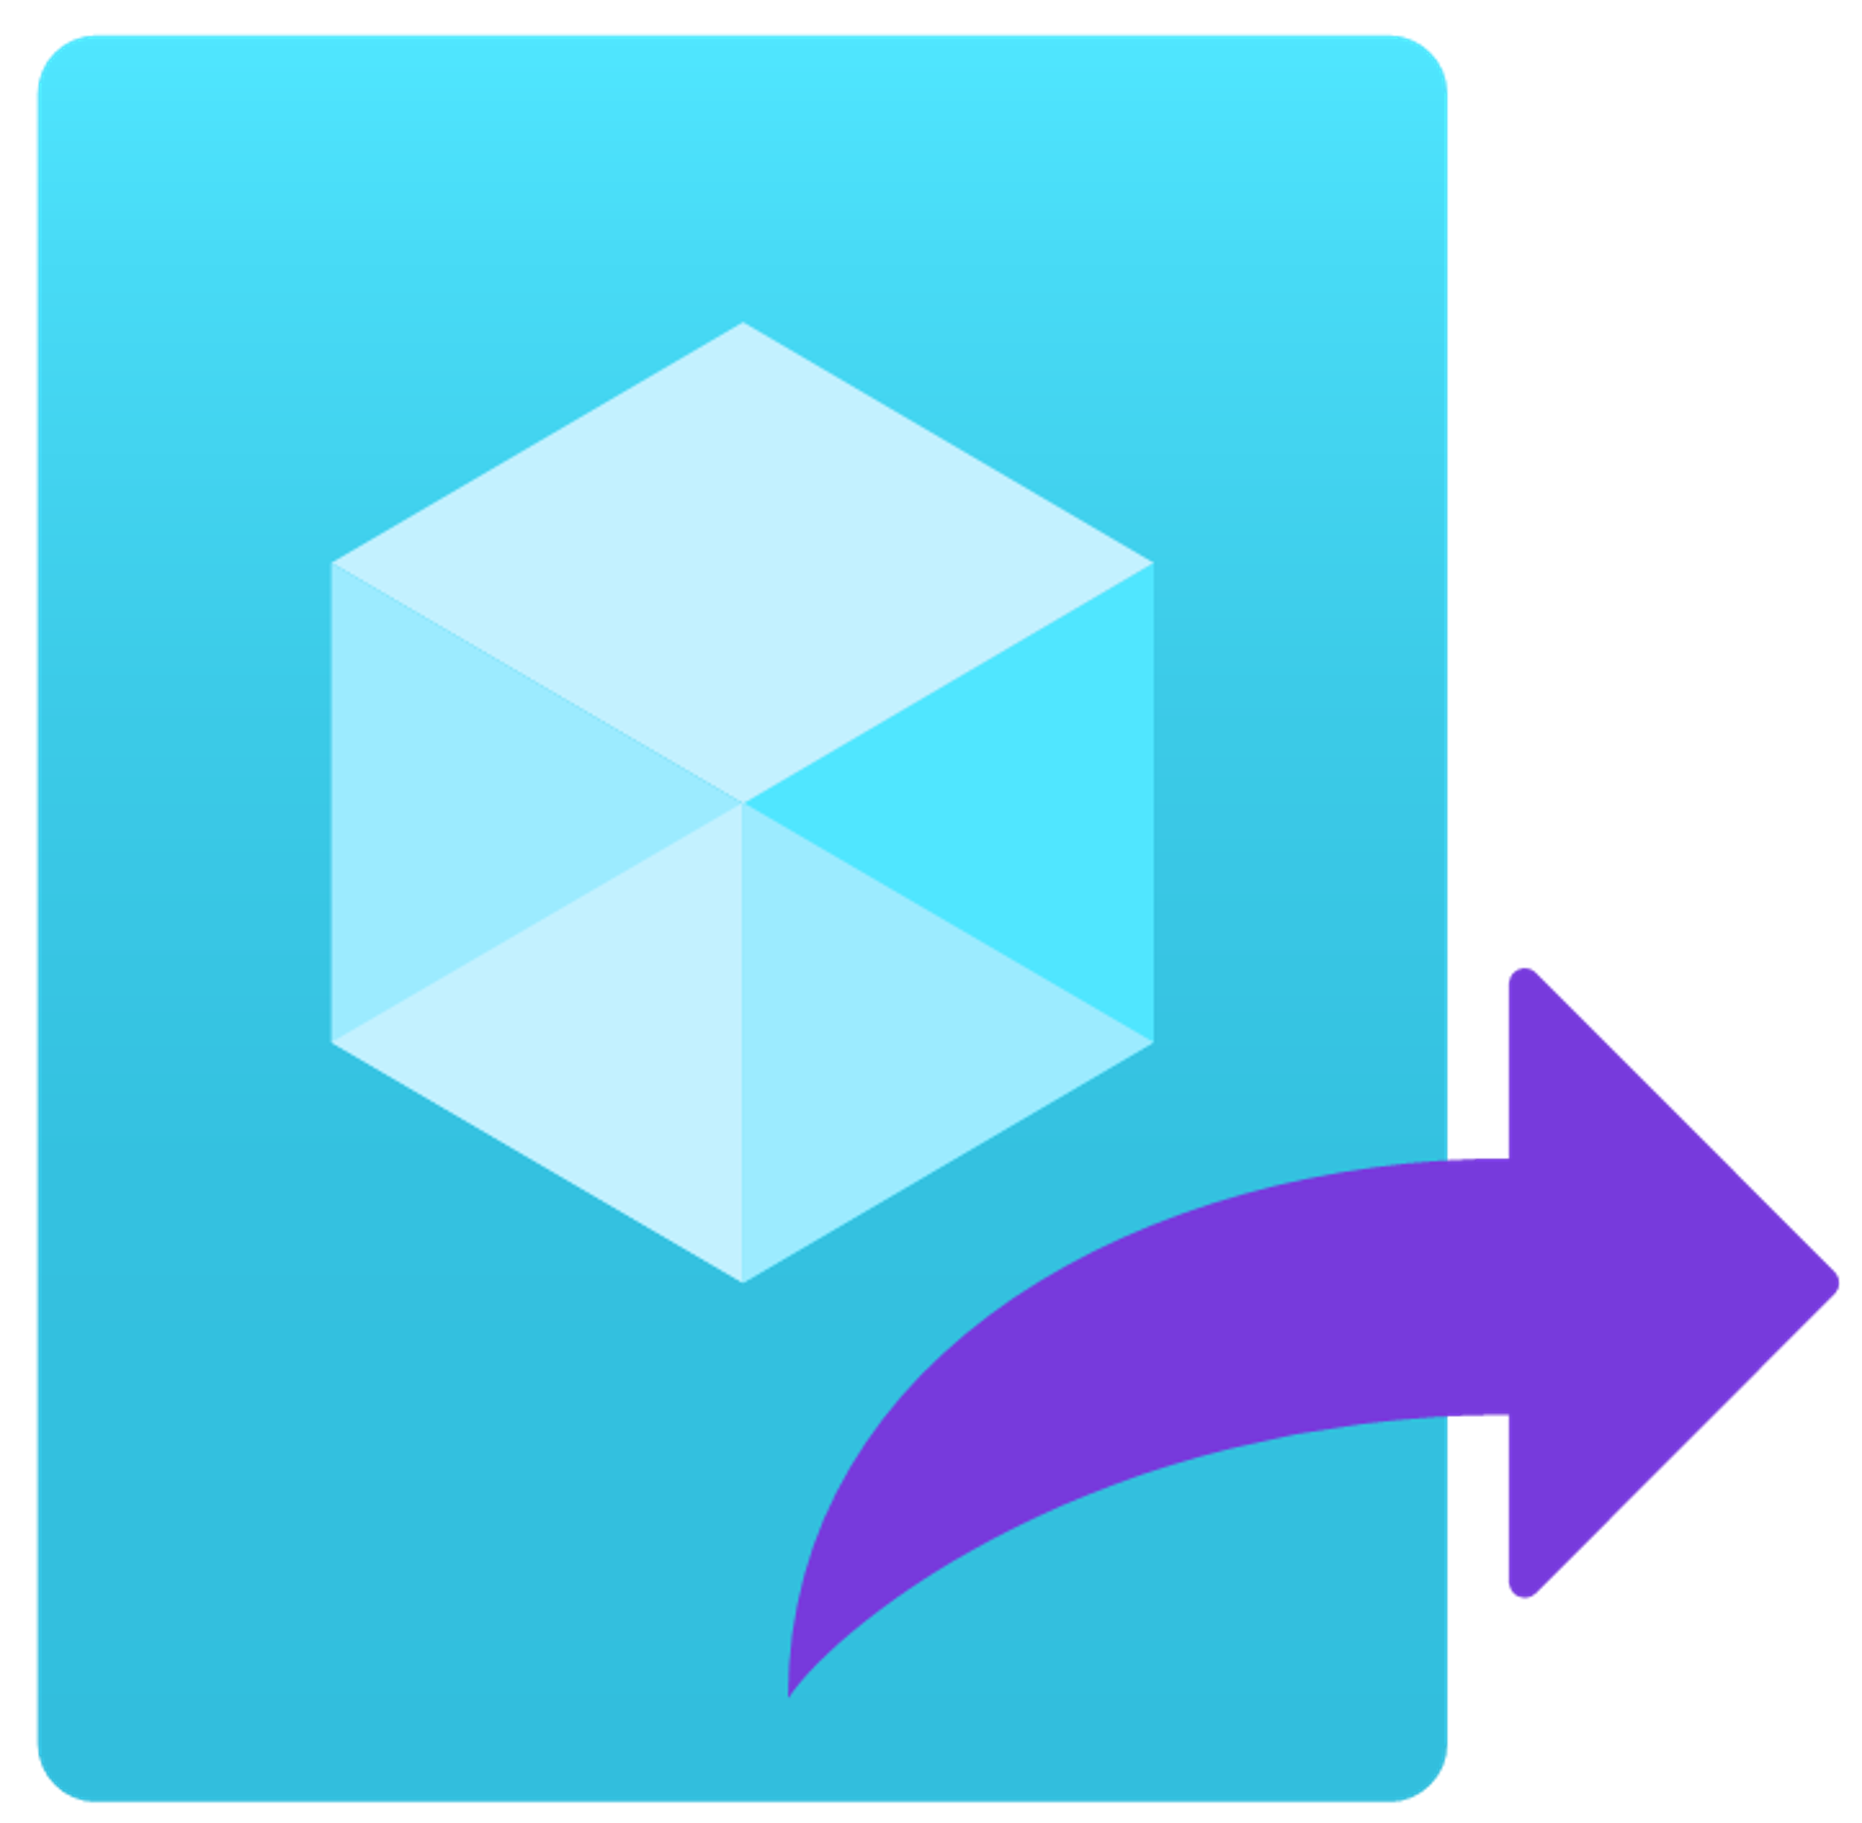


Pipeline deployments
used
by
register new
Agent Pool
Azure Image Builder
construct
Azure DevOps Scale Set
construct
Common Azure Resource Modules Library

Slide 6




Resource Group
Azure Compute Gallery
Storage Account
VNET
Image (Definition)
Container (system)
Subnet
Image Version
Compute
Image
3
VHD Image
2
(temp) Virtual Machine
3
2
Phase 1
1
Packer
Phase 2
2
Phase 3

